Slide 1

“We cannot direct the wind, but we can adjust the sail”
Discovering meaningful actions in the face of institutional change
Notes:
*Who said this?*
There are a lot of similar quotes attributed to many folks, including Dolly Parton, Thomas S, Monson, Bertha Calloway, Jimmy Dean, and several others.

Slide 2

Gratitude
Grateful to be leading this workshop in the territories of the the Lək̓ʷəŋən (Songhees and Kosapsum), Malahat, Pacheedaht, Scia'new, T’Sou-ke and W̱SÁNEĆ (Pauquachin, Tsartlip, Tsawout, Tseycum) peoples.
Grateful also to the work and dedication of ABEABC conference organizers for putting together this event.
This Photo by Unknown Author is licensed under CC BY

Slide 3
What to expect
Stage 1: WHAT?
Goal: Separate what we can know from the interpretations or conclusions we have come to.
Stage 2: SO WHAT?
Goal: Critically examine what we know and start building or rebuilding understandings from shared information.
Stage 3: NOW WHAT?
Goal: With new understanding, consider what beliefs drive actions and what actions might make sense.
Stage 4: 15% Solutions
Goal: Discover what is possible in your sphere of influence and get support planning your next steps.
This Photo by Unknown Author is licensed under CC BY
Notes:
We will work through highly structured discussions about the current state of institutional change. If this isn’t what you are looking for and you would like to duck out to another session please do!

Slide 4
What, So What, Now What? W³
Make sense of complex challenges in a way that unleashes action

Slide 5
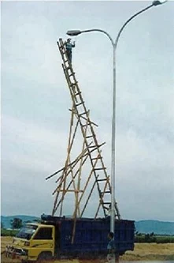
Ladder of Inference
A mental model you can use to help slow down decision making, critically assess thinking, or test “gut reactions”
We need to start on stable ground before moving higher up the ladder!
Image from: “When is a Ladder NOT the answer?” by Ivelina Dulkova. https://www.hls.co/blog/when-is-a-ladder-not-the-answer
This Photo by Unknown Author is licensed under CC BY
Notes:
**THIS IS REALLY HARD**
https://online.hbs.edu/blog/post/ladder-of-inference
It relies on you accepting that humans tend to self-select information that reinforces their current view, and being willing to resist the boomerang or backfire effects new, different, or challenging information can cause
https://en.wikipedia.org/wiki/Belief_perseverance
https://en.wikipedia.org/wiki/Boomerang_effect_(psychology)
Example from Harvard Business School:
You notice that oat milk usage has spiked this month.
You immediately associate the spike with a past instance when increased usage was caused by staff doubling up on paper cups.
Based on that pattern, you conclude that baristas are likely overpouring oat milk.

Slide 6

Ladder of Inference
Stage 3:
Now What?
Actions | I take based on beliefs
Beliefs | I adopt about the world
Conclusions | I draw from assumptions
Assumptions | I make based on meanings
Meanings | I add (cultural & personal)
Data | I select from observations
Observable data and experiences
Stage 2:
So What?
Stage 1: What?
This Photo by Unknown Author is licensed under CC BY
Notes:
Our solid foundation will be observations and data, and we will move through each step with our group to support us.

Slide 7
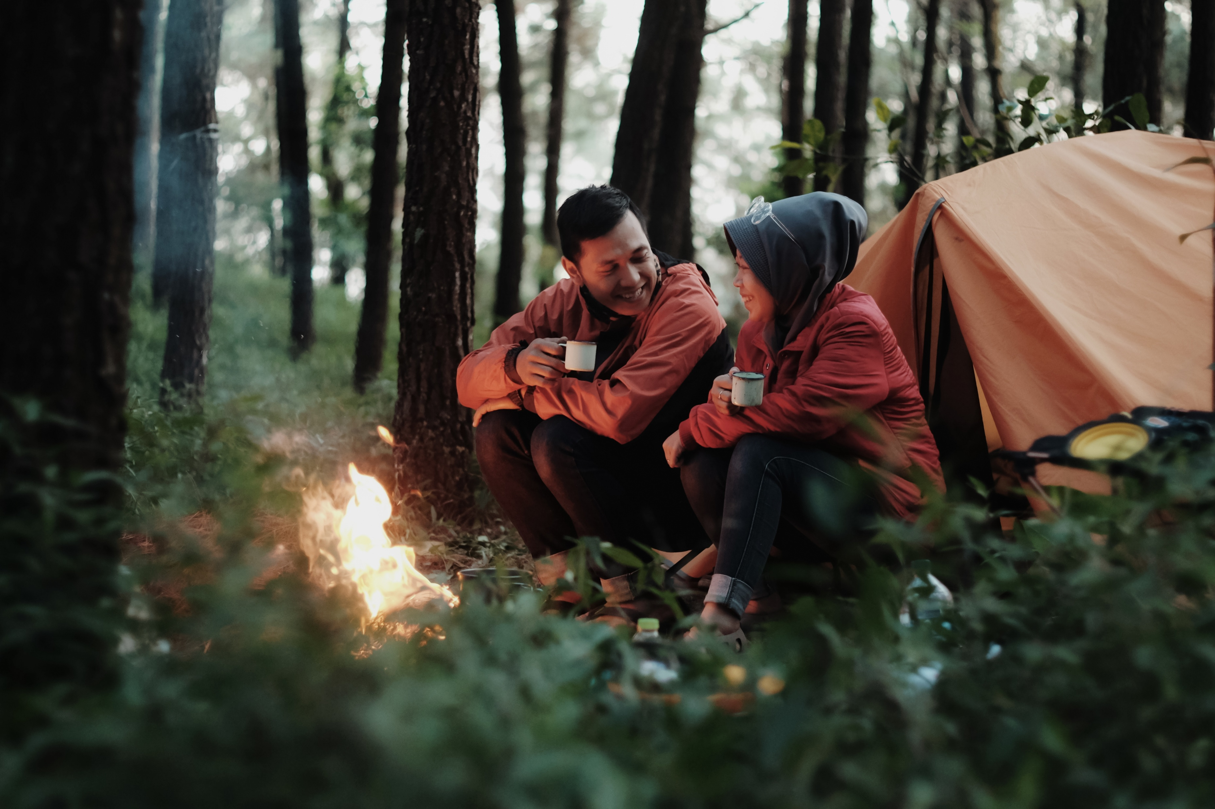
W³ : Example 1
Notes:
What? – Observations / Data
Two people, looking at each other, smiles
Cups in hands
Fire in front of them
One tent behind them
Trees around them
Green foliage visible
So What? – Meanings / Assumptions / Conclusions
It is cold
It is spring or summer
These people like each other, might be in a relationship
They are camping together
Now What? – Beliefs and Actions
(Personal)
(Ridiculous example) We need to put together a rescue operation!

Slide 8

W³ : Example 2
Notes:
What? – Observations / Data
Group of people around a table
Some people using laptops
Some people talking to each other
Person at front is smiling (strained?)
Graphic says “Roadmap to product launch” behind them
View on laptop matches view on screen
So What? – Meanings / Assumptions / Conclusions
They are work for a company / in corporate
They are stock photo actors
Something is happening / someone is talking off to the right (based on line of sight)
Person in red is presenting / supporting
Now What? – Beliefs and Actions
- (Personal)

Slide 9
W³ : Set the Stage
Most of our institutions have faced significant change in the last few years – leadership, budgets, staffing and supports, student demographics and needs, or other big shifts that trickle down to our everyday work.
In small groups, we will work through “What, So What, Now What?” to try to make sense of these changes in a way that allows us to create reasonable actions.
Each stage will last 5 to 8 minutes, followed by a share out from each group
This Photo by Unknown Author is licensed under CC BY
Notes:
**STOP and organize into groups if they haven’t yet: 5 to 7**

Slide 10
Stage 1: WHAT?
Observable data and experiences
Consider your own institution
What did you see, hear, experience, or directly observe related to changes at your institution?
How did you learn information (for example: through governance, word-of-mouth, official or unofficial channels)?
Timing
1 minute to write/think alone
5 – 8 minutes in your group
Each group shares 2 observable facts they found together
This Photo by Unknown Author is licensed under CC BY
Notes:
*Before alone time:
Remember: the expression of emotions can be observed as a "What" (e.g., "many people were smiling and laughing" rather than suggesting people were "happy")
Try not to get stuck in negativity / complaints – if you are struggling because of *feeling* data, try shifting to *observation* data
Try to collect items that are observable at this stage, don’t jump to meanings (this is very difficult!)
*While in groups:
Remember: everyone in the group needs to share at least one observation
*Circulate*
*Share out:
Ask: What are the important/saliant facts we need to consider together?
Will circle around each group – share one fact at a time – no lists!
Groups can skip if they feel everything has been covered
**THREE** rounds max
Sort facts if group is struggling with this round:
Facts with Observations (e.g., every person in the group spoke)
Facts with Feelings (e.g., I felt joy, people in my group were smiling and laughing, I moved through despair into hopefulness)
Non-facts

Slide 11
Stage 2: SO WHAT?
Meanings, Assumptions, and Conclusions
Building from what was shared as a group
What meaning is layered on the observations (based on personal, historical, or cultural background)?
What patterns do you see? What assumptions are being made?
What are the conclusions you see given the meaning, patterns, and assumptions?
Timing
1 minute to work/think alone
5 – 8 minutes in your group
Each group shares 2 discoveries
This Photo by Unknown Author is licensed under CC BY
Notes:
*Before alone time:
- Tip: Try to engage with meanings, patterns, or assumptions if you are tempted to start with conclusions.
*While in groups:
Remember: everyone in the group needs to share at least one observation
*Circulate*
*Share out:
Ask: What are the main meanings, assumptions, or conclusions your group found together?
Sort if group is struggling with this round:
Patterns (data is repeated)
Conclusions (if/then/because)
Educated guess (not as firm as conclusion, requires some amount of extension of facts)
Will circle around each group – share one fact at a time – no lists!
Groups can skip if they feel everything has been covered
**THREE** rounds max

Slide 12
Stage 3: NOW WHAT?
Beliefs and Actions
Consider what patterns and conclusions we noticed
What actions make sense given these patterns/conclusions?
Answers can be at any level right now: personal through to institutional and system levels.
Timing
1 minute to work/think alone
5 – 8 minutes in your group
Each group shares out 2 actions or beliefs
This Photo by Unknown Author is licensed under CC BY
Notes:
*Before alone time:
-
*While in groups:
Remember: everyone in the group needs to share at least one observation
*Circulate*
*Share out:
Ask: What are some of the actions that make sense after moving through the steps of inference?
Will circle around each group – share one action at a time – no lists!
Groups can skip if they feel everything has been covered
**THREE** rounds max
Invite insights based on what was shared (depending on timing)

Slide 13
15% Solutions
Discover and focus on what each person has the freedom and resources to do now

Slide 14
15% Solutions
When we are faced with these larger challenges, it is easy to feel as if we do not have a place in the solution, or that it is too large for us to solve
In this activity, we will identify what small, doable actions we have capacity for that move us forward
The idea is *not* to solve anything, but to identify where we have control and capability
This Photo by Unknown Author is licensed under CC BY
Notes:
**STOP and organize into groups, encourage people to get up and find new groups. 2 to 4**
Why? Purposes
Move away from blockage, negativism, and powerlessness
Have people discover their individual and collective power
Share actionable ideas and help one another
Build trust
Close the knowing-doing gap

Slide 15
15% Solutions
Consider the actions identified in the final stage of W³
Assuming your access to resources (your own time, budget, staffing, etc.) does not change, what could you do, or stop doing, to make a small positive change – personally or professionally?
Timing
5 minutes to work/think alone
4 – 6 minutes per person in the group
  Each person takes turns sharing out
  Other group members act as consultants – ask clarifying question or offer insight from experience to help make ideas concrete
This Photo by Unknown Author is licensed under CC BY
Notes:
**There will be NO requirement to share out beyond your small groups, but there will be a “final thoughts” opportunity**
This can look like anything: commitment to self-care, joining a committee or working group, reading a book, starting a conversation in the office, committing to leaving the office on time twice a week – anything that starts positive momentum for you.
*Before alone time:
- Remember: It is expected that actions may be specific to you or your role – they do not need to apply to everyone!
*While in groups:
Remember: everyone in the group needs to be given the time owed to share and consult (timer on screen)
Remember: ask clarifying questions to help make actions real do not try to adjust someone’s 15% to match your institution/experience
*Circulate*

Slide 16
Final Thoughts
This Photo by Unknown Author is licensed under CC BY
Notes:
Would anyone like to share a 15% solution or another insight from the session?

Slide 17
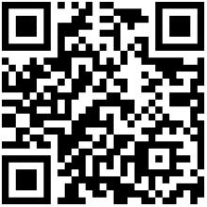
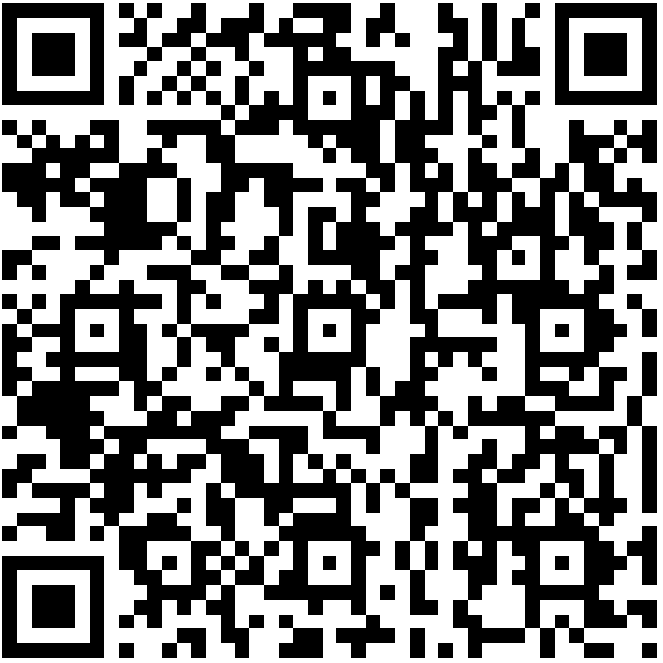
Resources
Liberating Structures: https://www.liberatingstructures.com/
Mental health supports from the government of BC: https://bit.ly/4sUgSsg
This Photo by Unknown Author is licensed under CC BY

