Slide 1
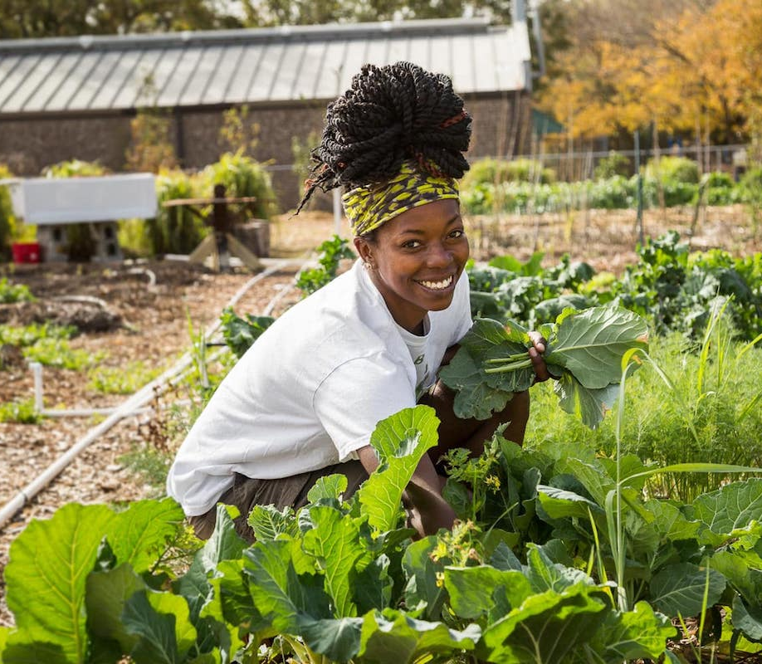
Restoring Balance: Integrating Movement, Mindfulness and the Medicine Wheel in the Classroom
Hannah Sanvido (She/her)

Slide 2
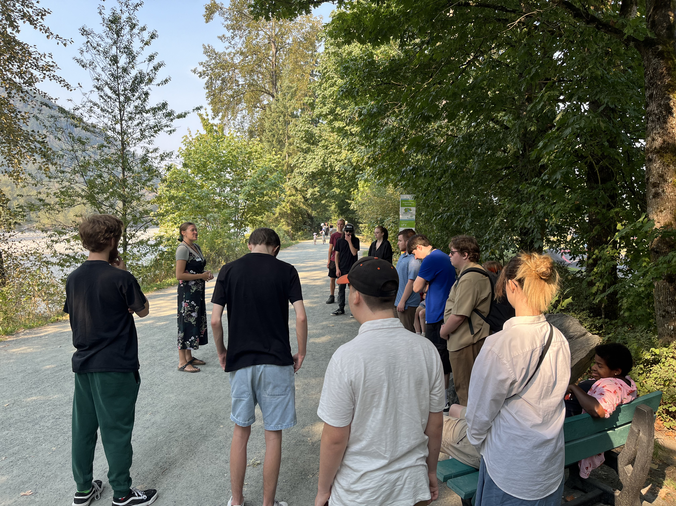
The University of Fraser Valley in Chilliwack is located on Stó:lō Téméxw

Slide 3
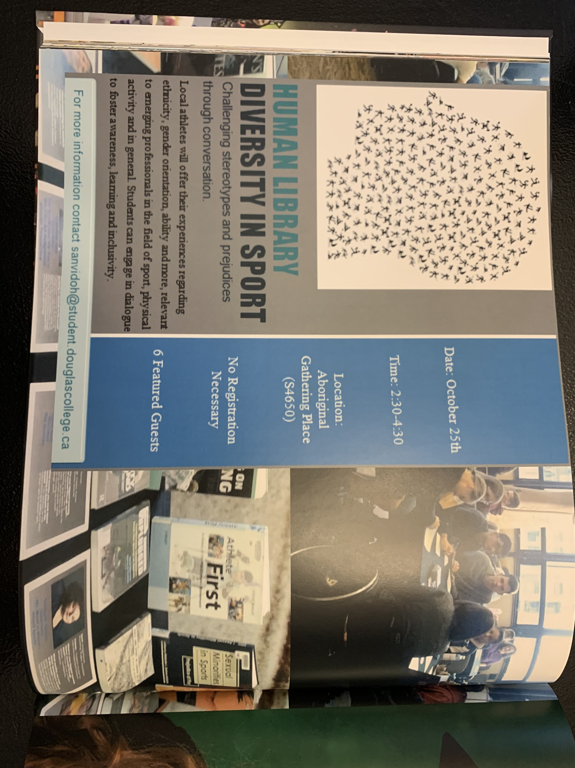
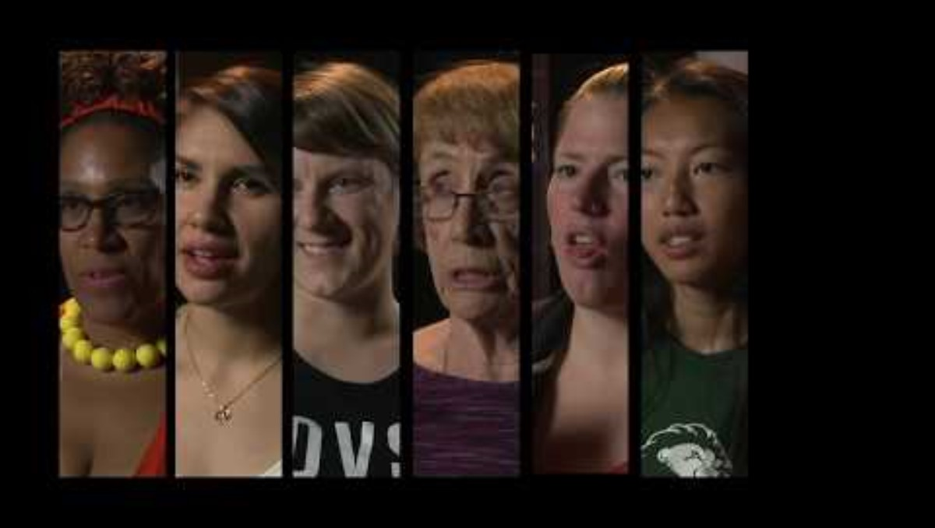
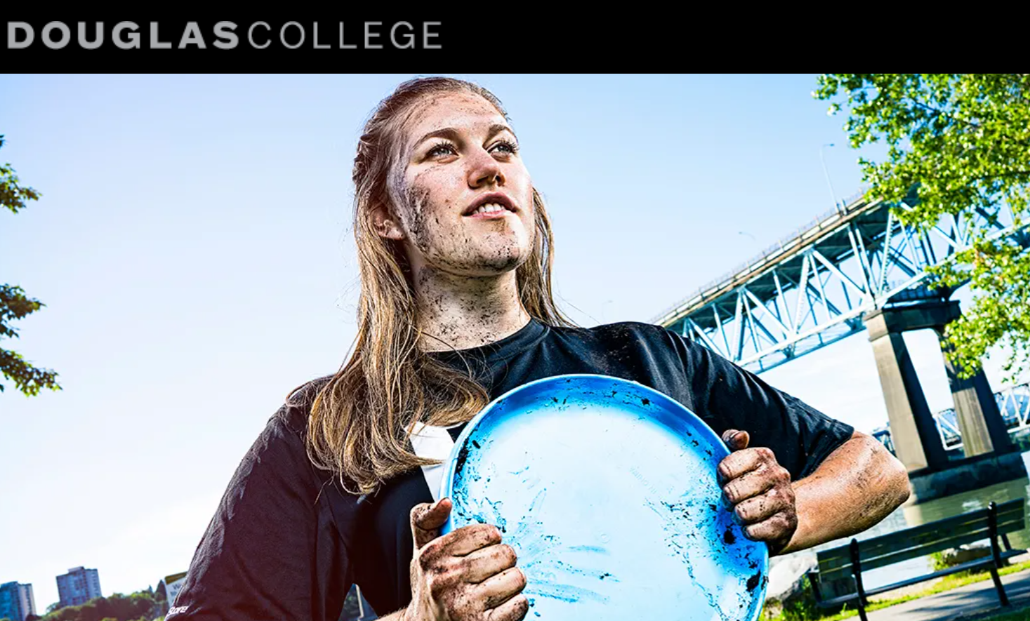

INTRODUCTION to me

Slide 4
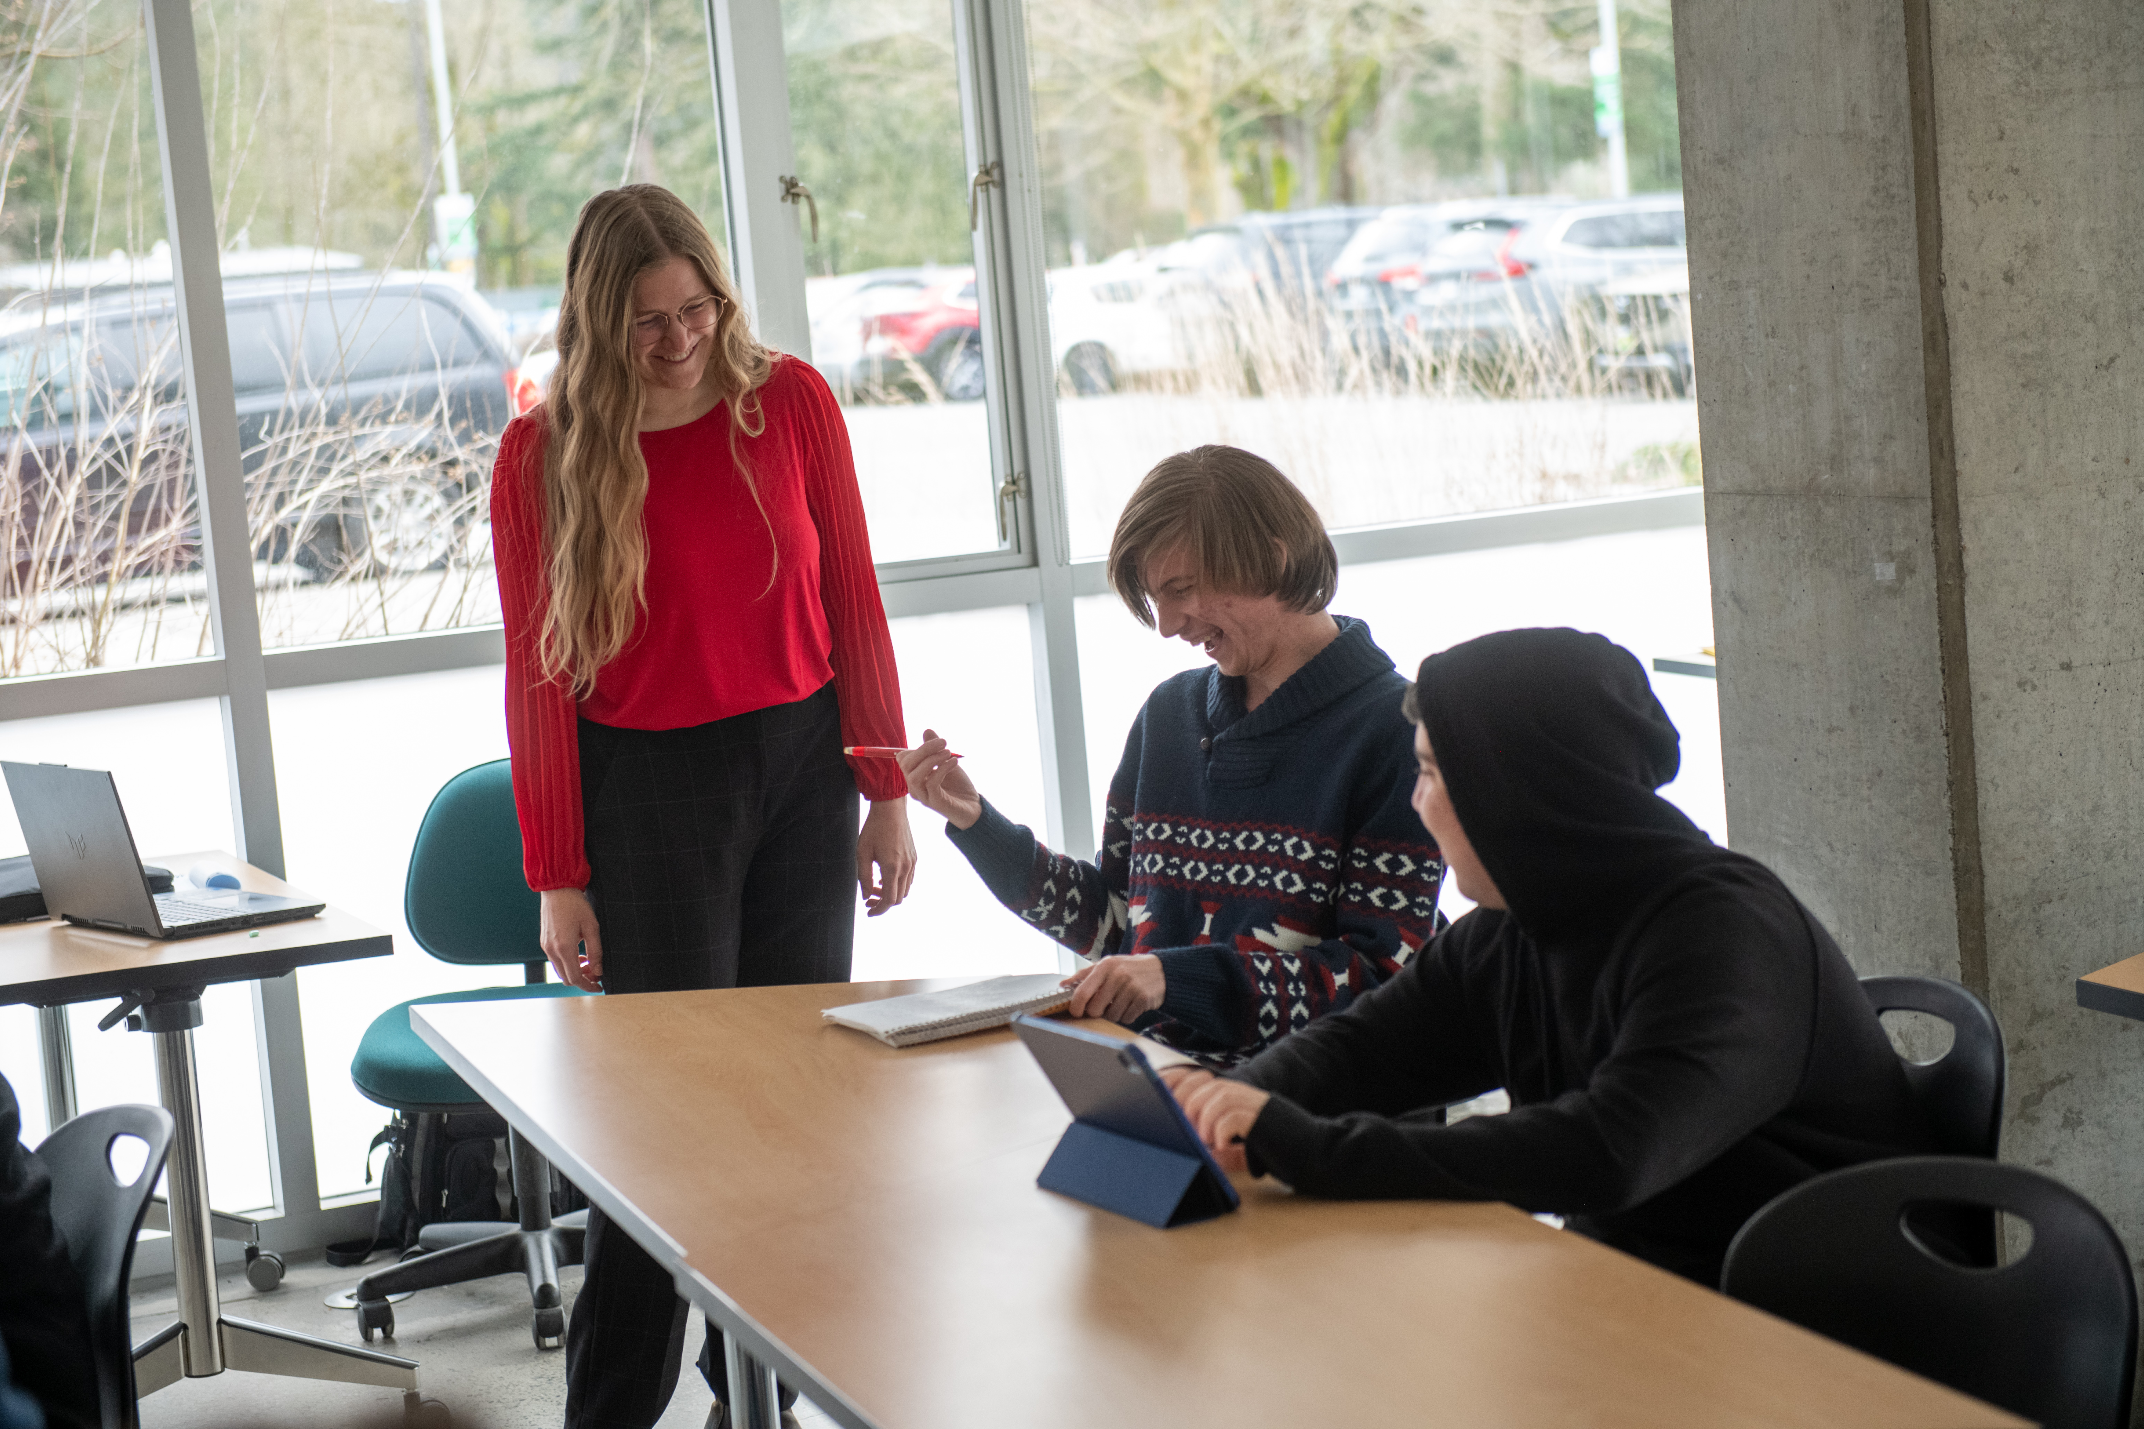
TASK
Pre-employment program for students with disabilities

Slide 5
Settle in
What do you need to do to be present for this session?
What are your access needs and are they met?
We all have access needs, some are more readily met than others
Notes:
Talk about my glasses

Slide 6
Share resources or techniques we have used in the classroom
3
Participate in movement
1
Brainstorm ways to stay active and well using the medicine wheel
2
Goals

Slide 7
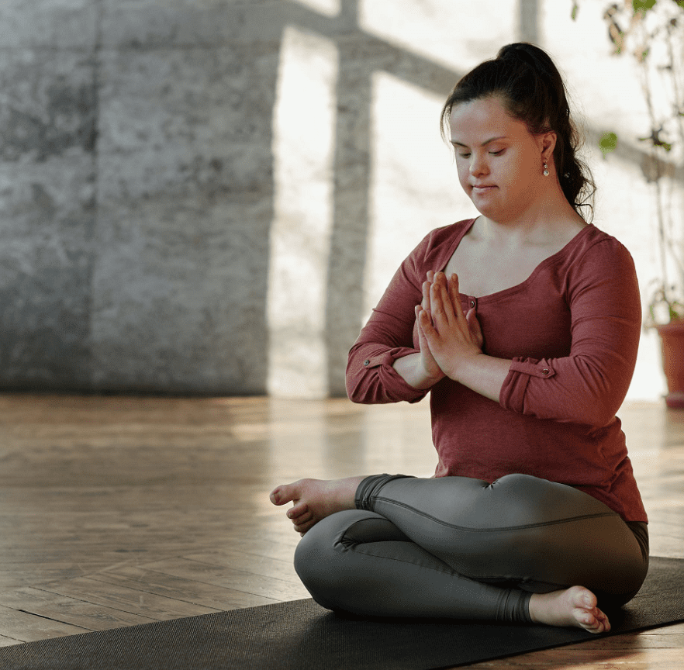
Yoga yoga yoga yoga yoga yoga yoga

Slide 8
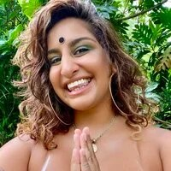
Practicing The 8 Limbs Of Yoga Will Help You Understand Yoga As It Was Meant To Be
Meesha is a queer Desi who created a virtual yoga studio was to reclaim their heritage and create a trauma-informed, intersectional, body positive experience for all folks who have felt ostracized by cultural appropriation, white supremacy, patriarchy, gender binary, the caste system and cisheteronormative culture.
Notes:
You cannot speak about wellness and different techniques without acknowledging their history and culture

Slide 9
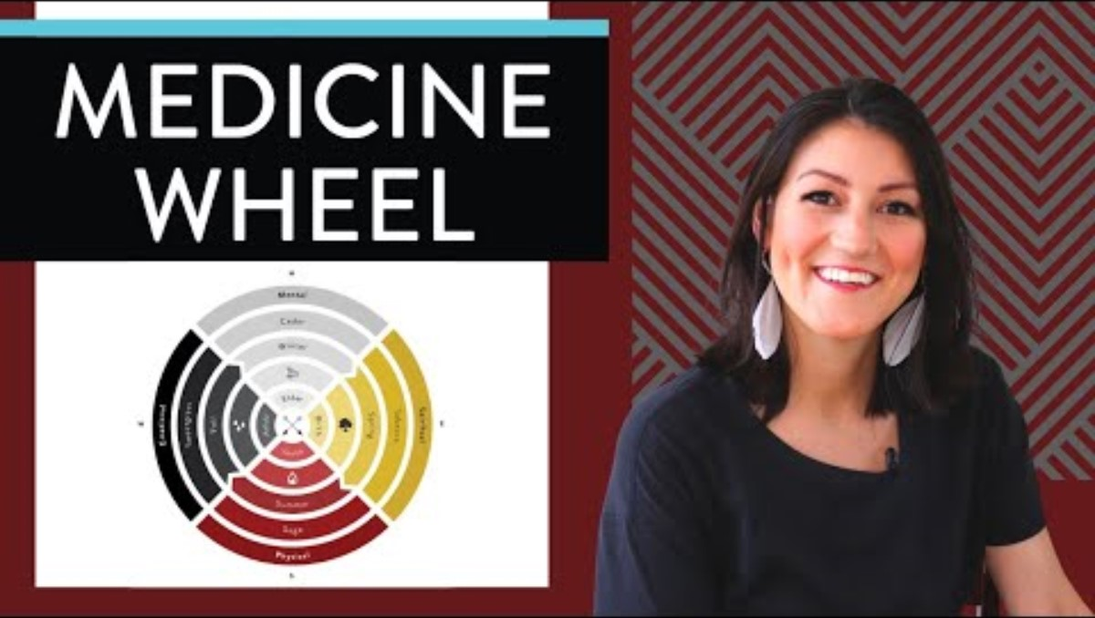
Notes:
Worse thing is to not do anything for fear or getting things wrong

Slide 10
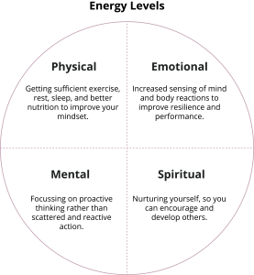
Directions
Label all four corners of the wheel (using these words or creating your own categories)
Fill in each section with examples of things you do
Be creative: complete it on a laptop, draw pictures, etc.

Slide 11
Examples
Mental (thinking)
Talking to a therapist, getting fresh air, meditation
Spiritual (connection)
Singing, playing music, religion, being in nature
Emotional (feel)
Talking to friends or family, letting yourself cry, asking for support, laughing
Physical (movement)
Kayaking, paddle boarding, soccer, ultimate, walks, volleyball, spikeball

Slide 12
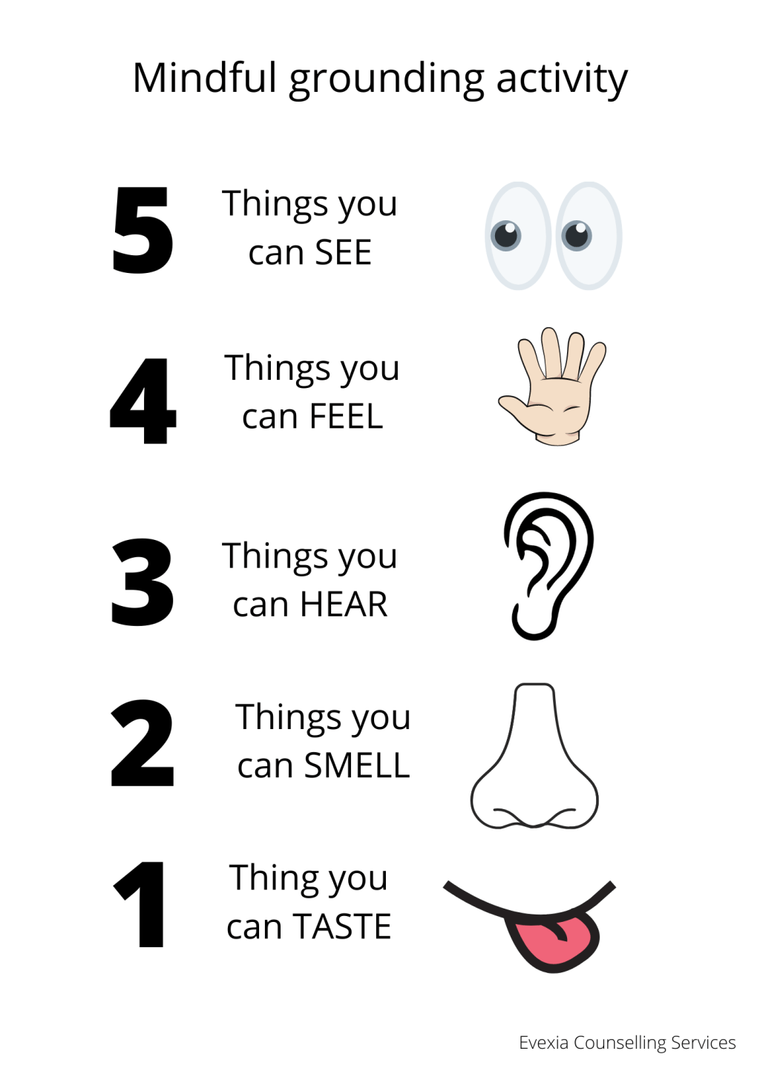
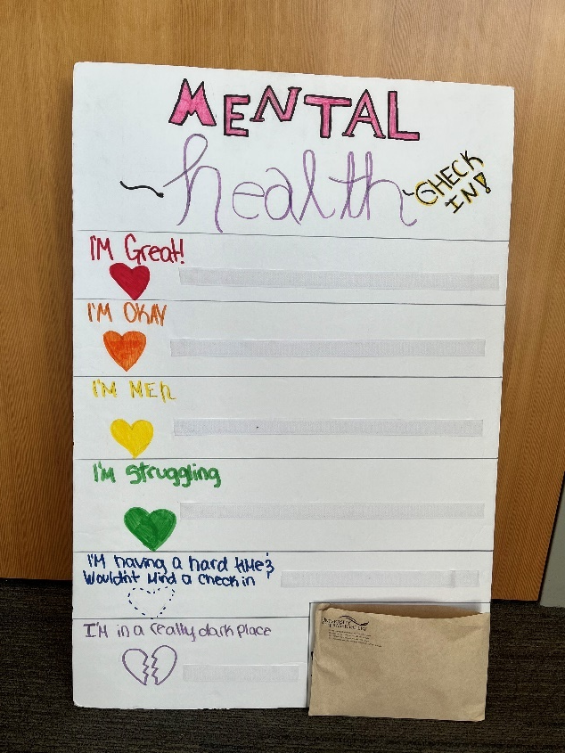
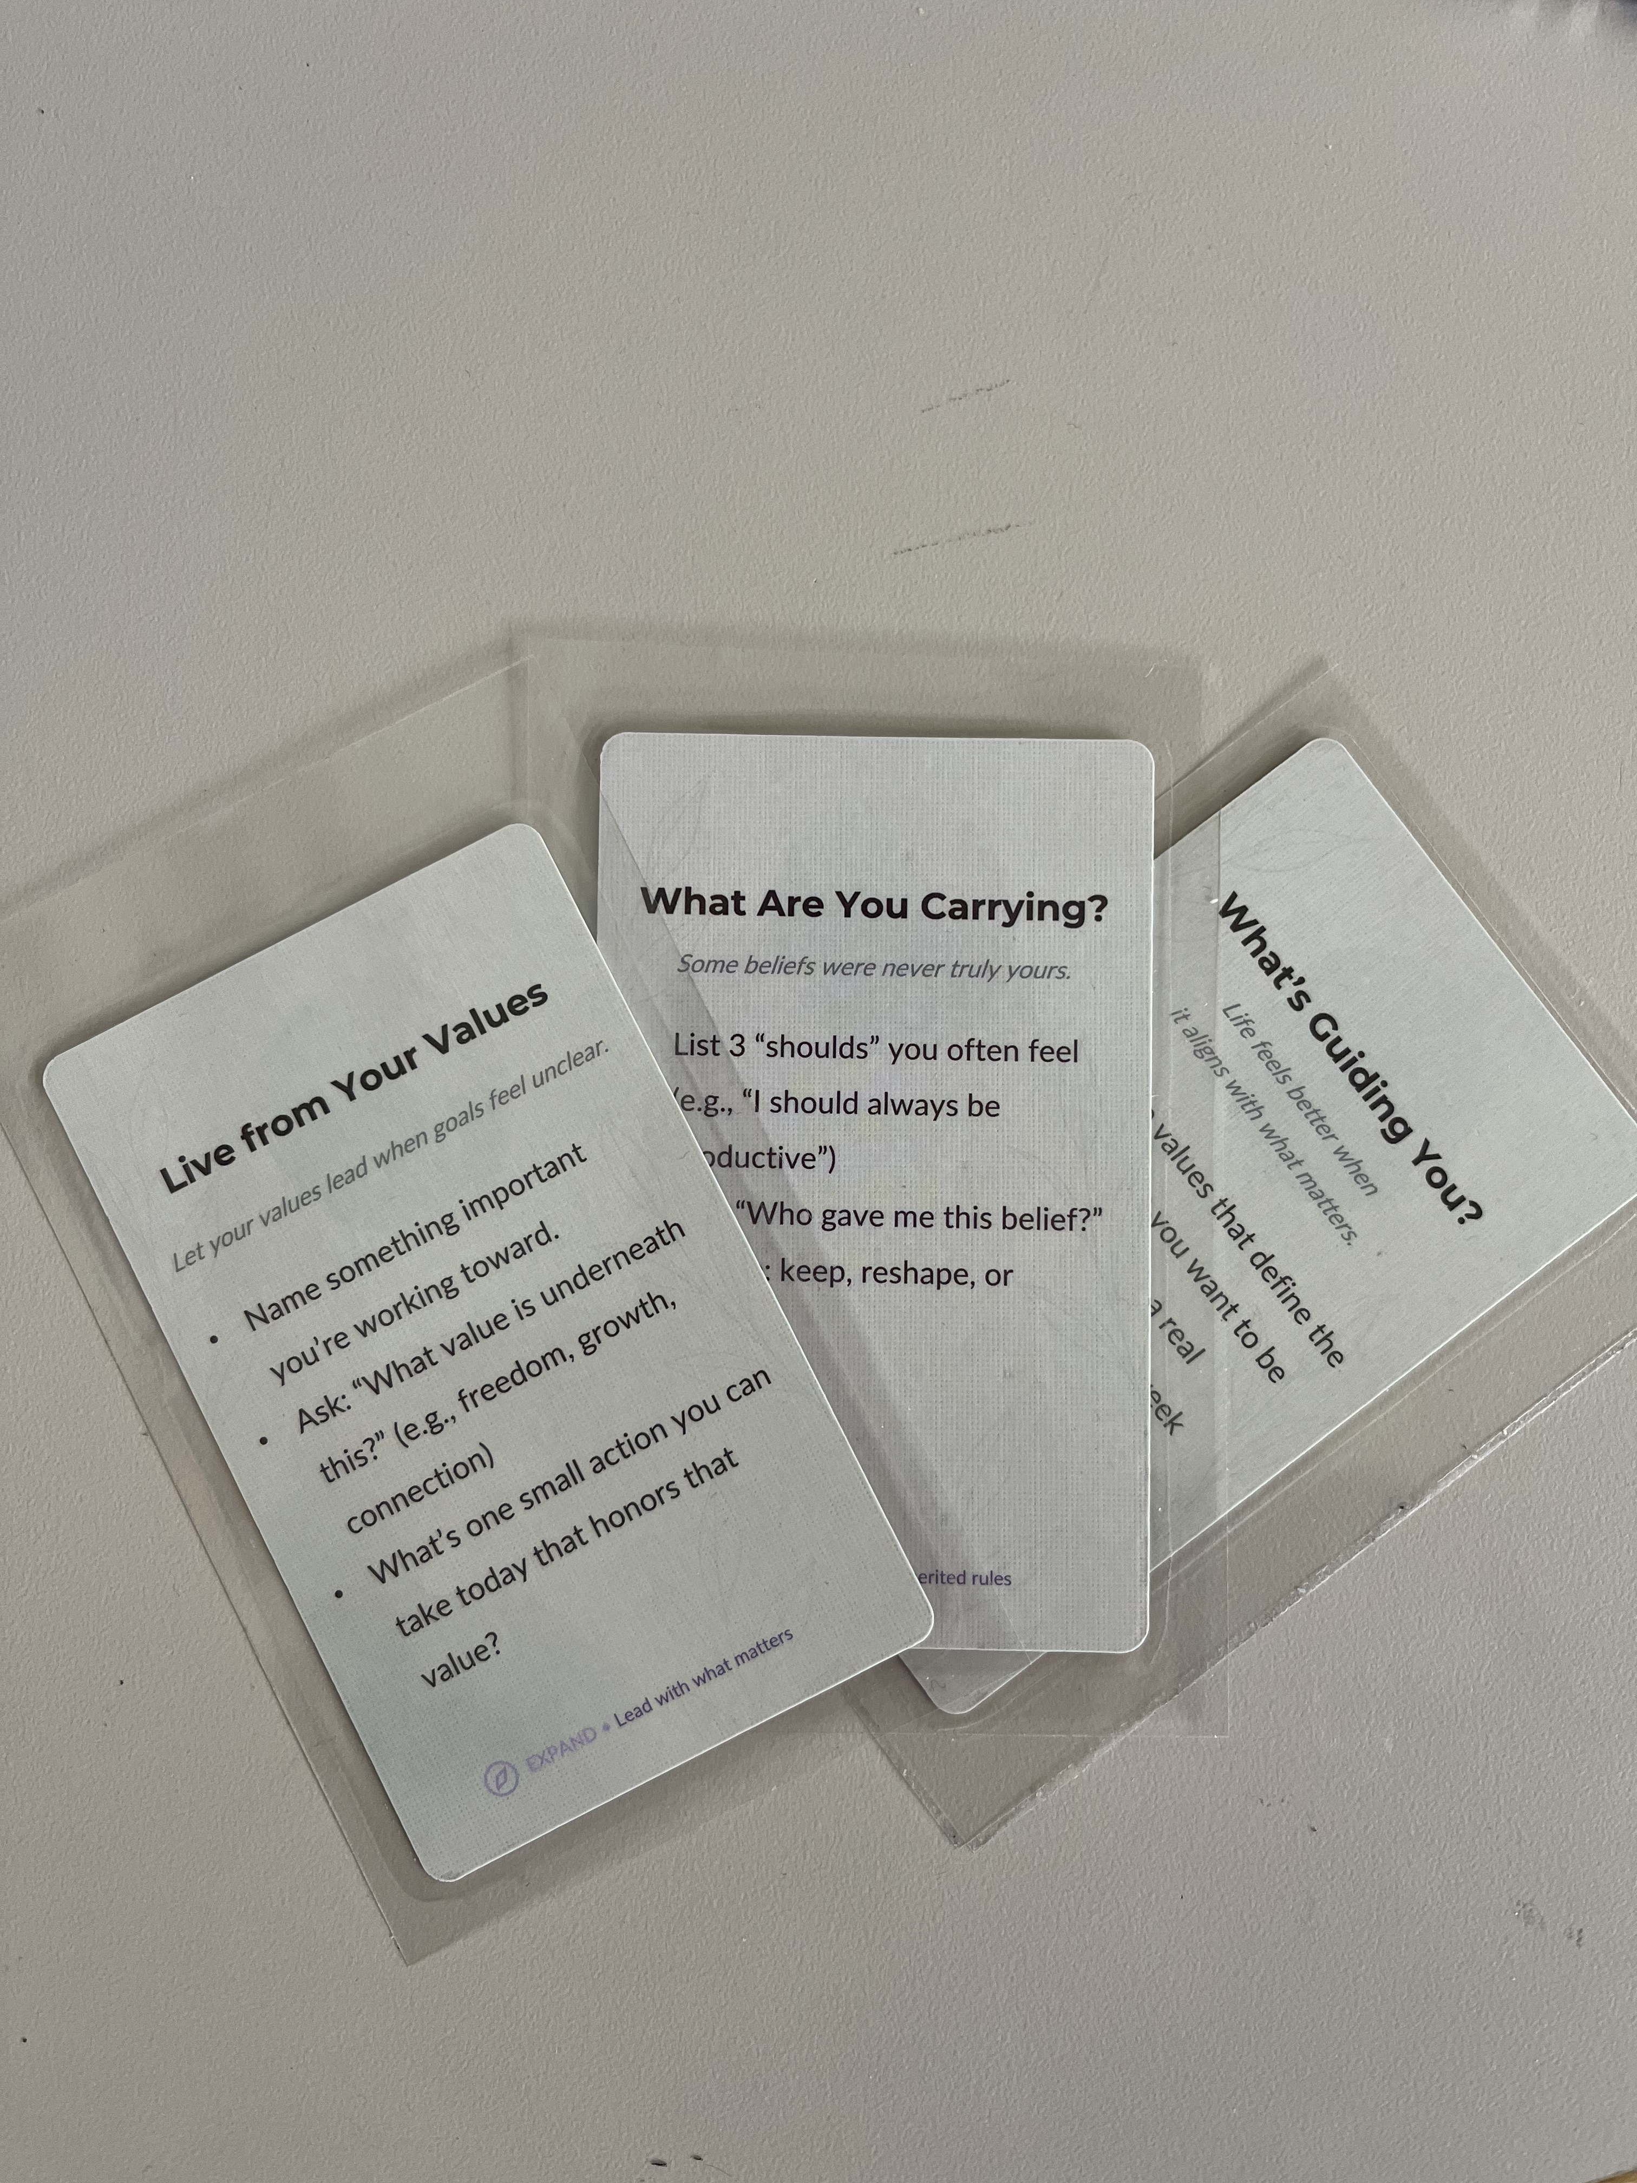
Resource Sharing
Notes:
I learned all of these from someone else, we can learn many things from each other

Slide 13
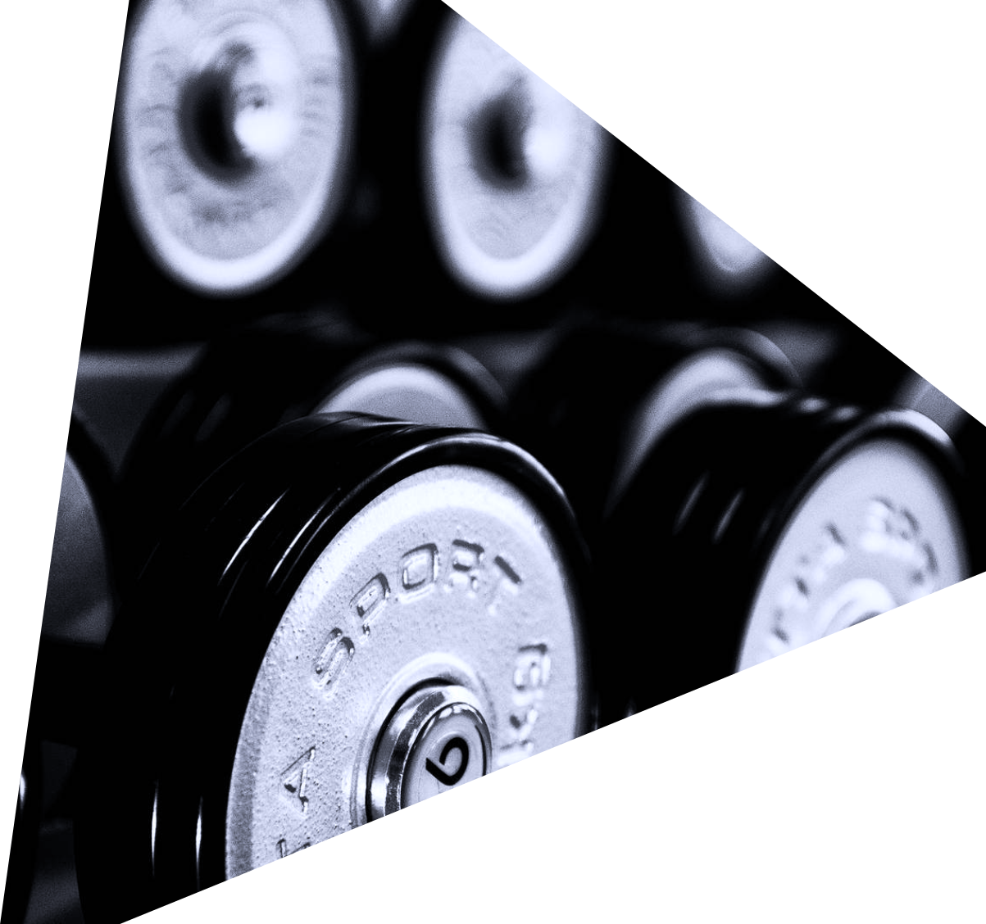
Thank You and Questions
THANK
YOU
THANK
YOU
THANK
YOU
THANK

