Slide 1

Centering Student Voice and Choice in AI-Enhanced Teaching and Learning
Gwen Nguyen, BCcampus LT Advisor, gnguyen@bccampus.ca
ABEABC Conference 2026
May 01, 2026

Slide 2

Territorial Acknowledgement
Reflection on where you are arriving from today: Choose a photo on your phone or hold an image in your mind’s eyes. (this image represent where you are coming from and how it connects to your intention for the next 50 minutes)
Pair and share.
Notes:
Take a quiet moment to think about where you are arriving from today. This may be a physical place, a place in your heart, or a feeling you are carrying with you.
You may choose a photo on your phone, or simply hold an image in your mind. Let this image represent where you are coming from today and how it connects to your intention for the next 50 minutes.
Next, pair up with someone. Share your image, or describe it if it is in your mind’s eye. Briefly explain what it means to you and how it connects to your intention.

Slide 3
Gwen’s GenAI Disclosure Statement
In this presentation, I have used ChatGPT to assist with generating downloadable QR codes, and refine some of the language in reflective prompts to make them clearer for all participants.

Slide 4
Discussion points:
Student Voice and Student Choice:
What and Why?
Where is student voice/agency muted in the learning process with AI?
Centering student agency in AI-enhanced teaching: “Loving out loud”

Slide 5
Icebreaker:
“Whose Voice is in the Room?”

Slide 6
1: Think/Write
2: Pair/Share and Rewrite
All: Debrief
Step 1: In one sentence, describe what student agency means in your context (1m)
Step 2: Add a second sentence beginning with: “Students lose agency when…” (1m)
Step 3: Pair_Share (2m)
Step 4: AI-sounding rewrite challenge (2m)
Choose one sentence and rewrite it to make it sound like a generic AI-generated workshop statement
Step 5: Reflect with the question: What do you think? What disappeared?
Notes:
This quick activity shows something important about using AI in learning. AI can help us put ideas into words, but it can also make our work sound so smooth that it loses the student’s voice, choices, context, and learning process. Today, we’ll explore how to use AI in ways that keep students at the centre — as thinkers, decision-makers, and creators of their own learning.

Slide 7
Student Voice and Student Choice:
What and Why?

Slide 8
Without motivation, there is no push to learn.
Without engagement there is no way to learn.
Without voice, there is no authenticity in the learning.
— Dr. Etic Toshalis and Dr. Michael Nakkula

Slide 9
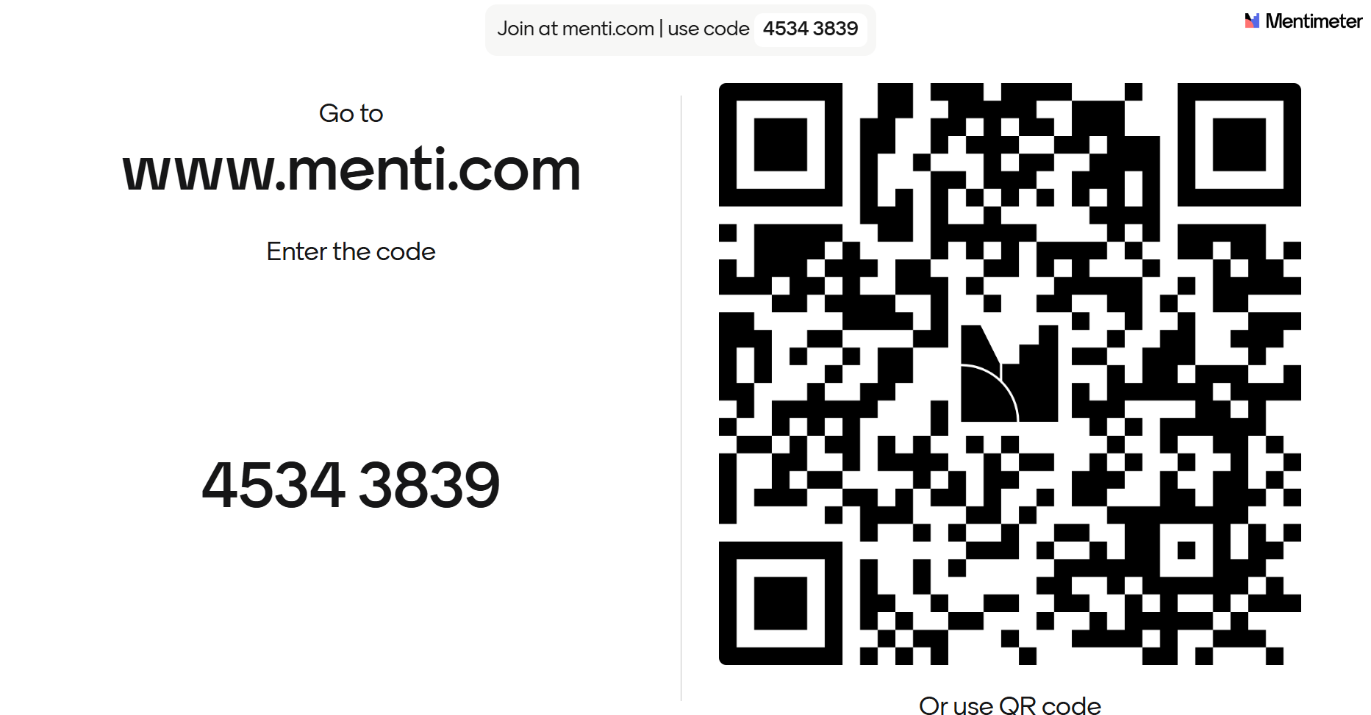
Mentimeter Reflection

Slide 10
Student-choice pedagogy
Student-voice pedagogy
intentional opportunities for students to select meaningful options in their learning
Integrating the values, opinions, beliefs, perspectives, and cultural backgrounds of individual students into the learning process
(Daoyang Biaddang and Caroy, 2024)

Slide 11
Student Agency
Student capacity to intentionally influence their learning experiences through goal-directed actions, metacognitive awareness, and strategic decision making

Slide 12
Suraez et al’s model of learner agency (2018)
Learner Agency
goals
content
Learning actions
Learning strategies
Reflection opportunities
Self-monitoring capabilities
voice
choice

Slide 13
Providing students with a place to voice their needs and interests, and a place for choice in the process, starts with teachers
--Garry, 2018, p. 5

Slide 14
Reflection Corner
How often do you intentionally invite student voice in your teaching?
When do you most often hear your student voices?
How much choice do students currently have in your course?
Why do you offer spaces for students to have voice and choice in their learning process?

Slide 15
Spectrum of learner voice-oriented activity
Expression
Consultation
Participation
Partnership
Activism
Leadership
Toshalis & Nakkula, 2012

Slide 16
Where might student voice and choice be muted when learning with AI?

Slide 17
Mentimeter Reflection

Slide 18
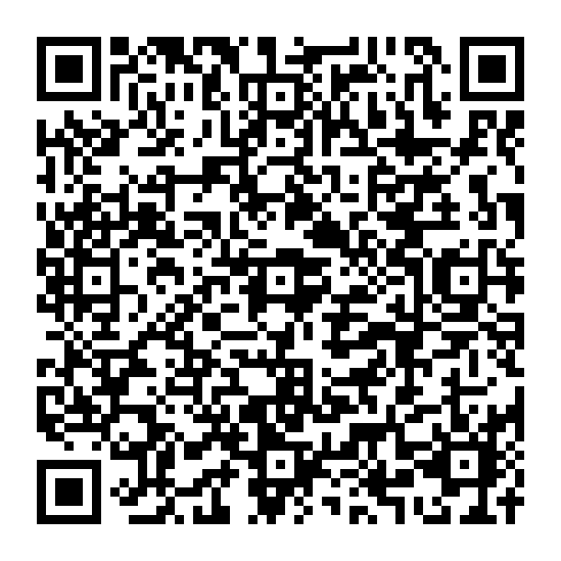
The case : 5 minutes
Choose ONE case that interests you
Work with the case:
Identify: How might this AI adoption mute or limit student voice and choice?
Reflect: What’s at stake for students’ agency according to Suraez et al’s framework of student agency?
Reimagine: What concrete actions would re-center student voice and agency in this situation?
http://bit.ly/4r6XwR5

Slide 19
Mentimeter Reflection

Slide 20
These characteristics (proactive recommendation, opacity, adaptive behaviour) position AI as active participant in educational decision-making, requiring careful consideration of how human agency is preserved within human-AI collaborative learning environments
— Suarez, 2025
Notes:
AI as mediating technology (proactive recommendation, opacity, adaptive behaviour) – AI becoming active participant in educational decision making process =. Thus, careful consideration of how human agency is preserved within AI collaborative learning environments

Slide 21
Where?
AI system focusing on efficiency ends up narrowing students’ curiosity and interests (goal)
AI system limits students’ access to diverse viewpoints and sources (content)
AI doing tasks for students reduces student ability to make decision and think critically (learning actions)
AI tools can discourage student from experimenting with alternative ways of learning (strategies)
AI feedback can remove the chance for student to reflect on their reasoning (reflection)
AI system offer analytic dashboard for administrators but not students (self-regulation)
(Suarez, 2025)

Slide 22
Students’ Perceptions of AI 2025
(Sue Attewell, 2025)
Anxiety about the speed of AI developments and how to keep up to date
Concerns around how AI could impact academic integrity
Worries of how AI impact entry-level roles and devalue skills
Calls for consistent, course-specific policies on AI uses and support or guidance on practical and ethical uses
Inclusion of their voice in shaping how AI is integrated into education

Slide 23
Centering student agency in AI-enhanced teaching: “Loving out loud”

Slide 24
Mentimeter Reflection

Slide 25
Choose one redesign focus and share one design move
How might students help shape expectations for ethical, meaningful and transparent AI use/approach?
How might students show learning in more than one way, with or without AI?
How can students notice AI’s impact on their thinking, voice, and choices?
Notes:
Think of one assignment, activity, discussion, lab, project, quiz, presentation, or learning task where students might use AI. Choose one small part of it that you could redesign to better protect or amplify student agency.

Slide 26
Continuum of Expert Learners
Voice
Choice
Engagement
Motivation
Ownership
Purpose
Self-Regulation
(Bray & McClaskey, 2015)

Slide 27
It is the job of educators to help students become better thinkers. Our new job is to help them become even better thinkers with AI.
— Bowen & Watson, 2024, p. 77

Slide 28
Cultivate a learning space that demonstrates student voice matters
Acknowledge your stance of AI in the course or the program
Invite students to co-draft AI use for the course
Establish AI advisory committee within the course and have student prepare AI literacy (misinformation and deepfake) lesson in the course or program
Design and offer support for different assessment pathways (learning with or without AI) so that students can contribute their thinking, values that AI cannot or do poorly
Offer space for self-reflection and co-reflection
Notes:
Voice and Choice in Student Learning | Teacher Education Resource Hub

Slide 29
Designing Learning for Human Efforts
I matter
I care
I can
Purpose: What skills or knowledge will I gain? Are they relevant? Can I use this in the future?
Challenge: what, how, when, where, what resources?
Criteria/ Validation: How will I know I’m doing good work? What matters the most? What am I contributing?
(Bowen & Watson, 2024, p. 185)

Slide 30
References
Attewell, S. (2025, May 22). Student perceptions of AI 2025. Jisc. https://www.jisc.ac.uk/reports/student-perceptions-of-ai-2025
Bowen, J..A., & Watson, C. E. (2024). Teaching with AI: A practical guide to a new era of human learning. John Hopkins University Press
Bray, B., & McClaskey, K. (2014). Make learning personal: The what, who, WOW, where, and why. Corwin Press.
Daoayan Biaddang, L. M., & Caroy, A. A. (2024). Student voice and choice in the virtual classroom: Engagement strategies. Discover Education, 3, 162. https://doi.org/10.1007/s44217-024-00269-6
Khedr, N. (n.d.). Voice and choice in student learning. Teacher Education Resource Hub – Scarfe Digital Sandbox. https://scarfedigitalsandbox.teach.educ.ubc.ca/voice-and-choice-in-student-learning/
Suarez, A. (2025). AI and learner agency: A framework for preserving student autonomy in educational technology. Rural, Digital y Descentralizado (RDD). https://ruralpreneur.substack.com/p/ai-and-learner-agency-a-framework
Suárez, Á., Specht, M., Prinsen, F., Kalz, M., & Ternier, S. (2018). A review of the types of mobile activities in mobile inquiry-based learning. Computers & Education, 118, 38–55. https://www.sciencedirect.com/science/article/pii/S0360131517302397
Toshalis, E., & Nakkula, M. J. (2012). Motivation, engagement, and student voice. Retrieved Nov 17, 2025 from http://www.studentsatthecenter.org/topics/motivation-engagement-and-student-voice.
Notes:
https://blog.mahabali.me/pedagogy/a-lesson-full-of-student-agency-and-a-tiny-bit-of-ai/

Slide 31
Questions

Slide 32
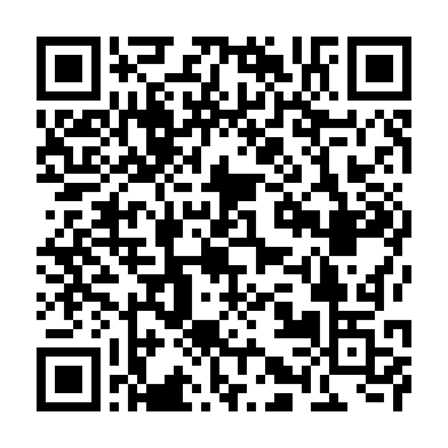
Thank you!
QR code to my blog
gnguyen@bccampus.ca

