Slide 1
Using Survey Feedback to Enhance Learning of Mathematics Through Webwork: Technology Acceptance Model
Notice Ringa
Thompson Rivers University
ABEABC Conference, April 30 - May 1, 2026, Camosun College

Slide 2
Objectives of study
Identify challenges students face when completing webwork assignments
Help improve engagement and performance
Guide instructional adjustments
Instant feedback
Multiple attempts

Slide 3
Outline of presentation
Webwork
Technology Acceptance Model (TAM)
TAM-Webwork survey questionnaire
Survey results, interpretation, intervention
Summary/conclusion

Slide 4
What is Webwork?
Webwork is an online platform, which is used at many institutions for mathematics and science homework assignments or quizzes.

Slide 5
How webwork works
https://webwork.tru.ca/webwork2/Math_0600_Ringa_W26_S01/instructor/sets?effectiveUser=nringa
Create new homework: ‘HomeworkABEABC’
Add questions to the homework
Set opening & closing date
Solve some questions
Check student progress

Slide 6
Benefits of using webwork assignments
Adequate question library
Customizable problems
Individualized homework sets
Instant feedback
Multiple attempts

Slide 7
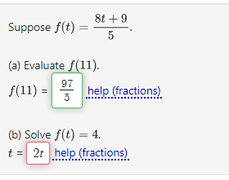
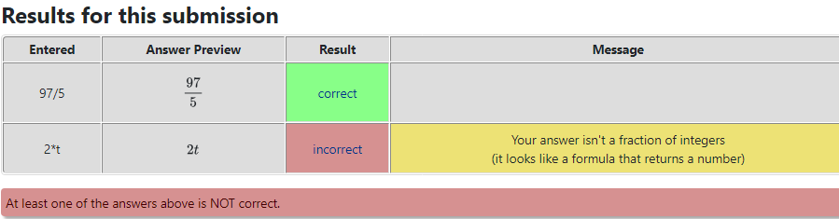
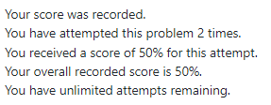
Benefits of using webwork assignments

Slide 8
Technology used for homework/assessment at other institutions? Good features? Challenges?

Slide 9
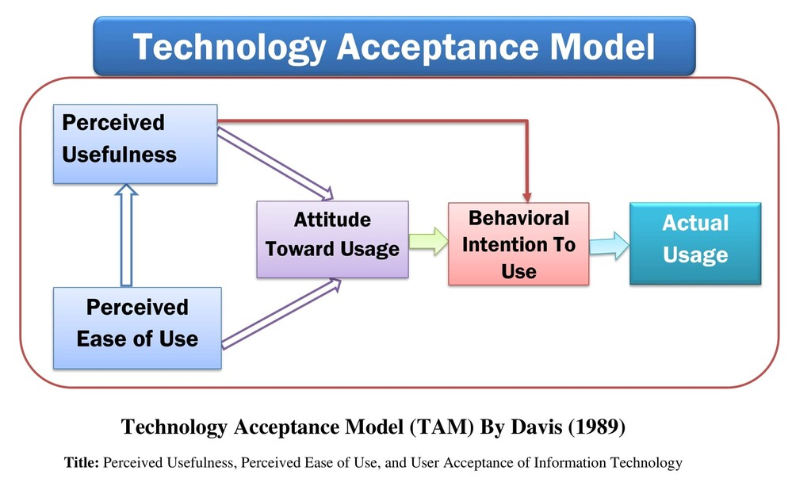
What is Technology Acceptance Model?
Technology Acceptance Model (TAM) is a theoretical framework that can be used to explain how users view and come to accept and use new technology.

Slide 10
What is Technology Acceptance Model?
Technology Acceptance Model (TAM) is a theoretical framework that can be used to explain how users view and come to accept and use new technology.
Degree to which a person believes that using a particular technology will enhance their job performance or help achieve desired outcomes
Degree to which a person believes that using the technology will be free of effort.

Slide 11
What is Technology Acceptance Model?
Technology Acceptance Model (TAM) is a theoretical framework that can be used to explain how users view and come to accept and use new technology.
Degree to which a person believes that using a particular technology will enhance their job performance or help achieve desired outcomes
Degree to which a person believes that using the technology will be free of effort.
directly influenced by the user’s attitude and perceived usefulness
-It is based on PU and PEOU

Slide 12
What is Technology Acceptance Model?
Technology Acceptance Model (TAM) is a theoretical framework that can be used to explain how users view and come to accept and use new technology.
Degree to which a person believes that using a particular technology will enhance their job performance or help achieve desired outcomes
Degree to which a person believes that using the technology will be free of effort.
- directly influenced by the user’s attitude and perceived usefulness
-It is based on PU and PEOU

Slide 13
TAM-Webwork survey questionnaire
Perceived Usefulness (PU)
Webwork helps me perform better in mathematics.
Overall, Webwork is useful for learning mathematics.
Attitude Toward Using (ATU)
Using Webwork for mathematics assignments is a good idea.
I enjoy using Webwork to practice mathematics.
I have a positive feeling about using Webwork.
Behavioral Intention (BI)to Use
I intend to continue using Webwork in my mathematics courses.
I would recommend Webwork to other students.
I prefer using Webwork over traditional paper assignments.
Perceived Ease of Use (PEOU)
Learning to use Webwork was easy for me.
I find Webwork easy to navigate.
I can use Webwork without needing much help.

Slide 14
RESULTS: Perceived Usefulness (PU)
New students
Experienced students
Generally, most students agreed that webwork is useful in learning mathematics; However, ‘some’ new students disagreed.
Interventions: Highlighted benefits of webwork; Explained how webwork supports learning; connected problems to exams and outcomes; emphasized learning over just correct answers.

Slide 15
RESULTS: Perceived Ease of Use (PEOU)
New students
Experienced students
Overall, most students agreed that it was relatively easy to learn how to use webwork. However, some students found it difficult to navigate webwork independently.
Interventions: offered technical support early in the term such as solution input format guided (e.g., fractions, syntax); reviewed common mistakes in class; discussed typical feedback provided by webwork.

Slide 16
RESULTS: Attitude Toward Using (ATU)
New students
Experienced students
Interestingly, many new students seemed to have developed a positive attitude toward using webwork, while many experienced students showed a neutral attitude.
Interventions: regular check-ins; praise students’ efforts; give shorter concept-specific assignments to make them less overwhelming; allow more time to complete assignments; help students view homework as an opportunity rather than a burden.

Slide 17
RESULTS: Behavioral Intention (BI) to use
New students
Experienced students
New students indicated the will to use webwork in future mathematics courses, but interestingly many of them prefer traditional paper assignments instead; Experienced students would recommend webwork to other students but have mixed views about traditional paper assignments vs. webwork.

Slide 18
Summary/conclusion
We developed survey questions derived from TAM to assess students’ views about webwork homework.
Although students indicated that webwork was helpful in practicing mathematics concepts, most students faced difficulties with navigating webwork.
We used survey feedback to help students improve performance in webwork homework.

Slide 19
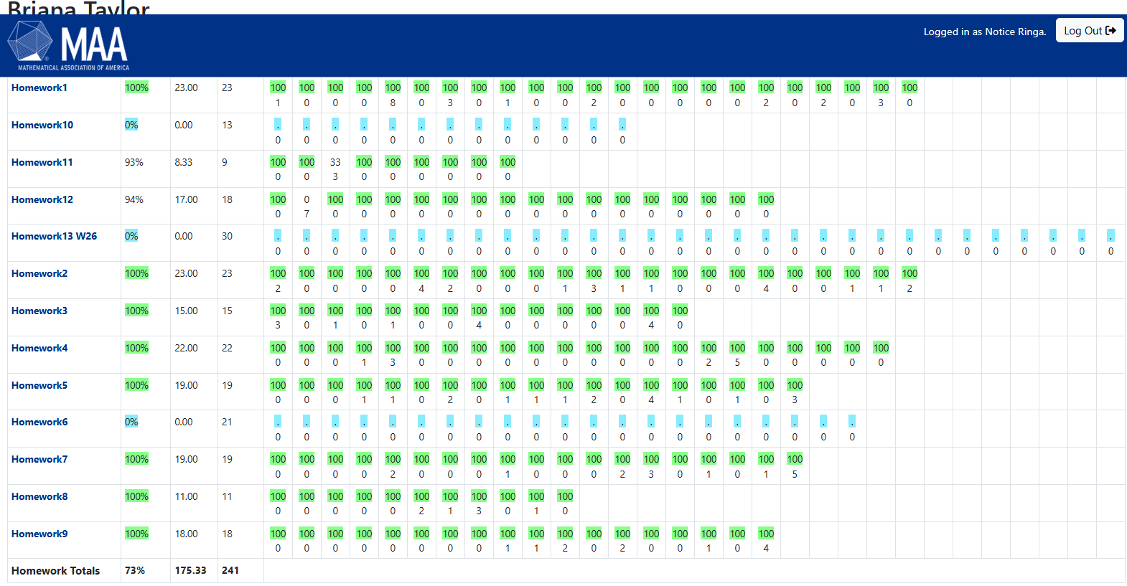
Grades for Student X

Slide 20
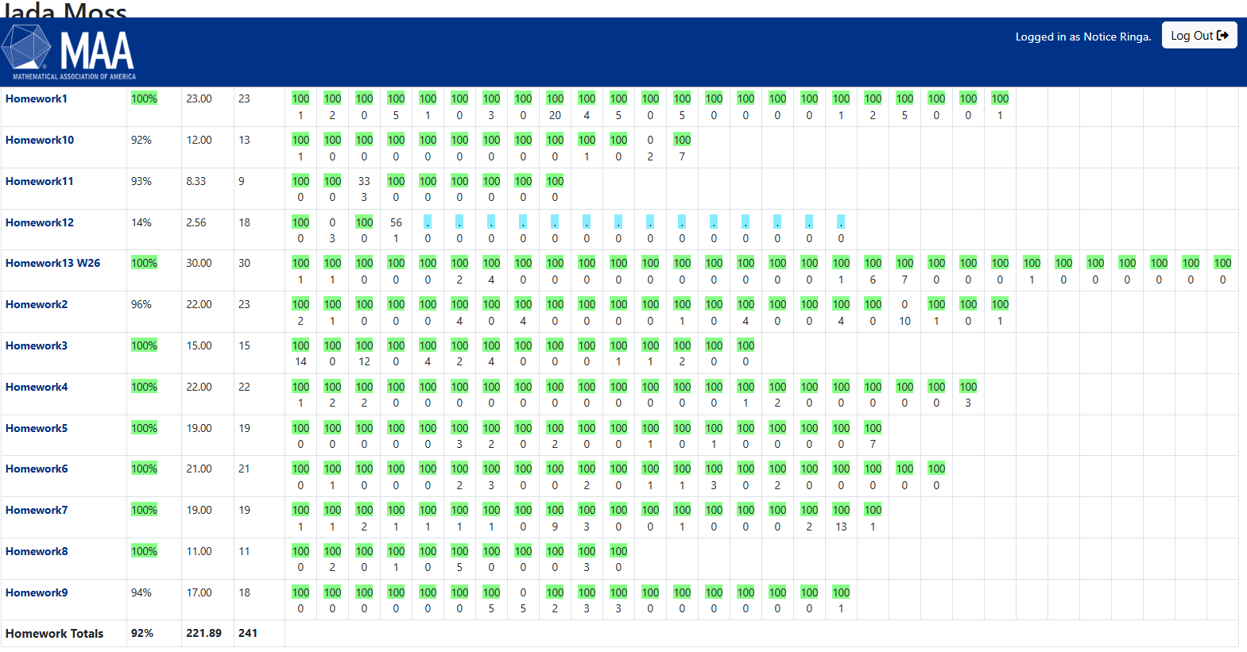
Grades for Student Y

Slide 21
Thank you

